Slide 1
Incident Response AKA Crisis Management
And why you should learn Excel
K “Turb0Yoda” Singh
Incident Response Consultant Forensic Lab Manager

Slide 2
About me
Incident Response Consultant at BlackBerry | Cylance.
Forensic Lab Manager for the global Incident Response Practice.
Apparently, part time DevOps
Ex-Kaiser E-Discovery/Internal Investigations
WRCCDC Black Team Member
Red Team Liaison, Infrastructure, Memes
CPP Alumni
SWIFT Eboard, FAST, SDC Director, SOC Director, CCDC, CBA Event mascot
Part-time car mechanik

Slide 3
Incident Response is not glamourous

Slide 4
Joanne plugged in that random USB and now everything is gone
Initial Access
Priv Escalation & Lateral Movement
Data Staging & Exfil
Credential Theft & Internal Recon
Recovery Tampering
Ransomware Exec
Extortion
The actual incident happens
Phishing/Spear-Phishing
BEC-IR(Business Email Compromise – IR)
Can pivot into a full-on Incident Response Engagement
Exposed RDP
You think I’m joking but I’m not
USB with worm plugged in
Ancient long-forgotten system still active
Insider Threat
Exfil via… NSFW methods
Banking Trojans
Emotet and Trickbot
Device Vulnerabilities and 0-Days
CVEs and 0-Days all day every day
ProxyLogon
Notes:
True Story: Within her first week a client’s employee wiped their backups by inserting a random USB with a worm. NGAV/EDR didn’t catch or stop it since it was in a lax and alert-only mode. Said Worm wiped out some infrastructure and backups.

Slide 5
What firewall logs? They got wiped.
Collection of data and locking down the environment.
How do you lock down an environment with no NGAV/EDR?
Next-Gen Anti-Virus/Extended Detection and Response
What about when there’s no firewall in place?
What’s a log?
No SIEM
Security Information and Event Management System
No central logging server
Microsoft E5? Too expensive- we only have E3
EG MailboxItemsAccessed not available in E3
What do you do when a box is completely nuked?
Ransomware
Rm –rf’d
Quick Collection Tools
CyLR
KAPE
Notes:
Ttitle- FW logs for Fortinet/Fortigate are wiped after updates

Slide 6
Index=RC03VPN-LAX
Analysis of Data
Dead Disk forensics is rare
EnCase
X-Ways
AXIOM
FTK
Autopsy/TSK
Cellebrite
On-the-Fly analysis
Kibana
Splunk
Timesketch/Plaso/Log2Timeline
Notes:
Live Demo

Slide 7

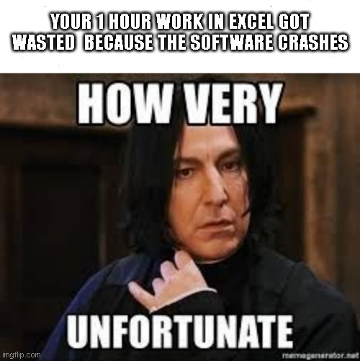
My Excel Crashed- please wait another day for the final report
Report Writing
What… you thought you didn’t need to pay attention in English?
Everything from the beginning to the end, and what the client should do.
Appendix Documents
Cells as far as the eye can see… It’s burnt into my eyes
Legal
Legal called and they don’t like how you worded this please spend 10 more hours fixing this 30 page report.

Slide 8
Thank you
Questions and Answers

Slide 9
Thank you
/in/ksahuja @Turb0Yoda

